Slide 1
How Cognitive Behaviour Therapy (CBT) and Mindfulness can boost your students’ self-confidence and self-esteem
Barbara Rose
TasTESOL Conference
April 2017

Slide 2
Teaching Matters: Hearts & Minds
Hearts ..... What your students FEEL
Minds ...... What your students THINK

Slide 3
What is Self-Esteem?
The Oxford Dictionary defines self-esteem as:
Confidence in one's own worth; self-respect.

Slide 4
What is Self-Confidence?
The Oxford Dictionary defines self-confidence as:
A feeling of trust in one's abilities, qualities, and judgment.

Slide 5
What is CBT?
The Oxford Dictionary defines CBT as:
A type of psychotherapy in which negative patterns of thought about the self and the world are challenged in order to alter unwanted behaviour patterns or treat mood disorders such as depression.

Slide 6
What is Mindfulness?
The Oxford Dictionary definition:
A mental state achieved by focusing one's awareness on the present moment, while calmly acknowledging and accepting one's feelings, thoughts, and bodily sensations, used as a therapeutic technique.

Slide 7
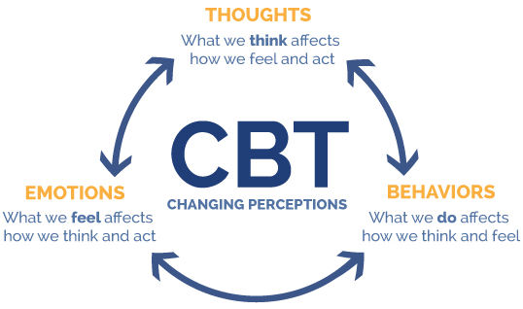
www.integratedhealthcareyork.com
Notes:
CBT is based on the idea that our thoughts, feelings, and behaviours are constantly interacting and influencing one another.
How we interpret or think about a situation determines how we feel about it, which then determines how we'll react.

Slide 8
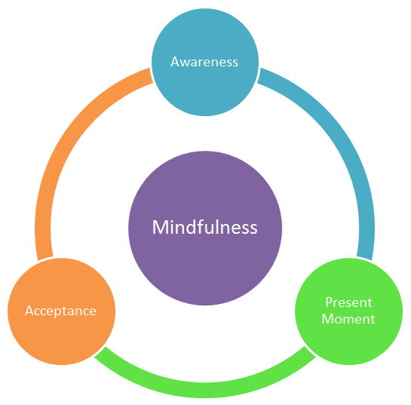
https://student.unsw.edu.aum
Notes:
Mindfulness requires us to think before we speak!

Slide 9
CBT MODEL
www.therapistaid.com
Notes:
CBT focuses on how the student perceives his/her experiences and how his/her perceptions influence the student’s behaviour.
For the purpose of this workshop – as teachers we want to focus on our students’ self-esteem and self-confidence.

Slide 10
LIMITING THOUGHTS - PERSPECTIVE
1. CATASTROPHIZING – your students imagine the worst possible outcome
I’m never going to be able to do this (whatever ‘this’ represents)
2. EXPECTING – your students form strict rules and unrealistic expectations of themselves.
I should do/be/have ...
FILTERING & MAGNIFYING – your students filter out the positive and magnify the negative
I keep doing it all wrong. I’m never going to be any good at ...

Slide 11
4. EMOTIONAL REASONING – your students decide that because something feels true, it must be.
I am so bad at this. I am incapable of doing this.
5. POLARISED THINKING – your students make blanket positive/negative assessments for whatever comes up
I am NEVER ... I will ALWAYS ...
6. LABELLING – your students name-call (which further limits their perceptions)
I am so stupid ...

Slide 12
LIMITING THOUGHTS - PEOPLE
BLAMING – your students blame themselves (or other people) for their problems/difficulties.
PERSONALISING – your students see all behaviours around them as responses to themselves.
eg: You could make a correction to the class, but the student thinks it was aimed at them.
COMPARING – your students measure themselves against others
I’m not as good as So-and-So.
Notes:
That student’s behaviour is making me lose concentration.
When the teacher makes a correction to the class, the student thinks it was aimed at them.

Slide 13
4. JUDGING – your students make superior/inferior judgements to determine their worth.
I am better than So-and-So at ...
5. MIND READING – your students now about another’s thoughts and motivations ... without a word from them.
She didn’t say hi before class starts. She must be upset with me.
6. PROVING – your students have a need to be right and show this through what they say and what they do.

Slide 14
WHAT YOU SAY IS IMPORTANT!
TRY ..… when you ‘try’, you are acknowledging the possibility of ‘failure’.
FAILURE ….. There is no such thing as failure! There is only not achieving the result that was hoped-for or expected.
SHOULD ..… this implies you have no choices.

Slide 15
WATCH WHAT YOU SAY!
Don’t try.
DO YOUR BEST (that’s all that can be asked of you)
There is no such thing as failure.
There is the creation of a LEARNING OPPORTUNITY.
SHOULD can always be replaced with a positive suggestion.

Slide 16
ASKING QUESTIONS
Students are reluctant to ask questions for a variety of reasons – the most common being:
Shyness
Language problems
Relevance
The Teacher/Student roles

Slide 17
ASKING QUESTIONS
1. Make a mnemonic for your classroom:
Always
Seek
Knowledge
2. Thank the student who asked the question ….. Because they created a learning opportunity for the rest of the class.

Slide 18
Is it True?
Is it Helpful?
Is it Inspiring?
Is it Necessary?
Is it Kind?

