Slide 1
TESOL and teaching language and concepts to a child with autism
a comparison
Lisa Risby 2nd November 2017

Slide 2
Outline
1. Autism spectrum Disorder (ASD) and possible causes
2. James as a case study
3. Early intervention program and developments
4. Issues
5. Reading and visuals
6. Concluding thoughts

Slide 3
A triad of deficits
Disorder/delay/deficits in:
Language and communication
2. Social interaction
3. Play and imagination

Slide 4
MChat (Modified checklist for autism in toddlers)
Pointing to share social information
Tracking maternal gaze ( joint attention)
Imaginative play with a tea set (rather than lining up/stacking the cups)
SACS – Social Attention and Communication Study

Slide 5
Causes???
Genetics – eg family studies (Gillberg)
Genome mapping – more than 1000 genes implicated?? Subtypes???
Excessive early growth of brain cells (Courchesne)
Arguably four times more prevalent in males
Environmental factors???

Slide 6
Expressive Language at 36 Months
Yes
No
All gone, all finished
More
Milk
Chip
Vo (video)
Open (general functional word) (8 items)

Slide 7
First Teaching Priorities
1. Teach single vocabulary items (initially nouns)
2. Teach classification skills to ensure more flexible concepts ( 1st noun to noun/then more generic nouns/ by function )
3. Oral imitation and shaping vocalisation (in steps if needed eg backward build-up)
4. Teach verbs with verb pictures/compic and also with actions in imitation(“Do this!)

Slide 8
Present Tense
“Do this!” (imitation)
“Show me standing/sitting/hopping etc!”
Later eliciting a verbal response to the question, “What are you doing?”- “Standing”
Expanding response to: “I am standing”
Later asking, “Stand up! What are you doing?”
Verbal response: “I am standing”

Slide 9
Past Tense
Asking, “Stand up! (expectant pause with accompanying facial expression) What DID you do?”
Response: “I stood up!”
Mix of regular and irregular past forms
James learned each past form separately
Later he “regularised/generalised” the “-ed” rule to form the simple past: “I goed, standed”

Slide 10
Future Tense
Asking James to, “Stand up!” (and grabbing him gently to stop him from moving, in a fun, anticipatory way) and asking, “What WILL you do!??”
“I will stand up!”

Slide 11
From Parallel Talk to Statement/Statement/Question
I like chips
I like bananas
I like blue
I like red. Do you like red too?

Slide 13
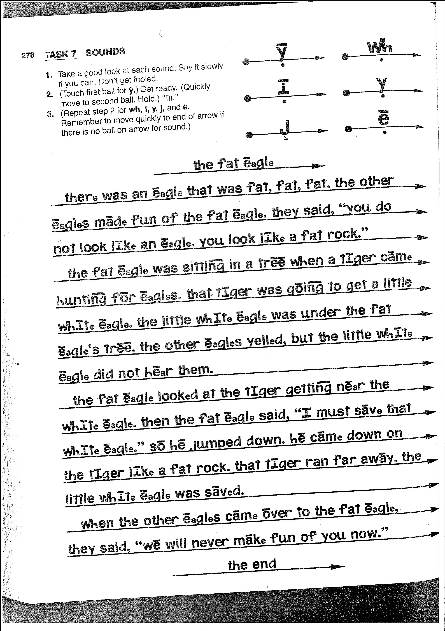

Slide 14
on-ly eight to ten syl-la-bles

Slide 15
References
Doidge, N. 2007: The Brain that Changes Itself, Scribe Publications, Carlton North Victoria.
Engelmann, S. et al 1983, Teach Your Child to Read in 100 Easy Lessons, Simon and Schuster, New York.
Frith, U. (ed.) 1991: Autism and Asperger Syndrome, Cambridge University Press.
Grandin, T. 1996, Thinking in Pictures, Vintage, New York.
Gray, C. 1994, Comic Strip conversations, Jenison Public Schools, Jenison, MI
Greenspan, S. – see stanleygreenspan.com DIRFloortime
Krashen, S. quoted in Harmer, J. (2007) and elsewhere The Practice of English Language Teaching, 4th Edition, Pearson.
Maurice, C. et al 1996, Behavioral Intervention for Young Children with Autism, a manual for parents and professionals, Pro-Ed, Austin.
Myles, B. S. et al, 2013, The Hidden Curriculum, AAPC Publishing, Shawnee Mission, Kansas.
Schmidt, R in Harmer, J see above, on “noticing” (metacognition too)
https://sites.educ.ualberta.ca (accessed 01/05/2017) quotes Segalowitz (2003) on automaticity
Silberman, S. 2015, Neurotribes, Allen and Unwin, Sydney

