Slide 1
A student-centred approach: the English Language Support Service for international students in Higher Education
Melania Pantelich
ELSS Co-ordinator
School of Education
m.pantelich@federation.edu.au

Slide 2
Melania Pantelich
ELSS lecturer and Early Career Researcher
Qualified English Language teacher – AMES and EAP
Currently building a research profile examining the experiences, acculturation and identities of international students.

Slide 3
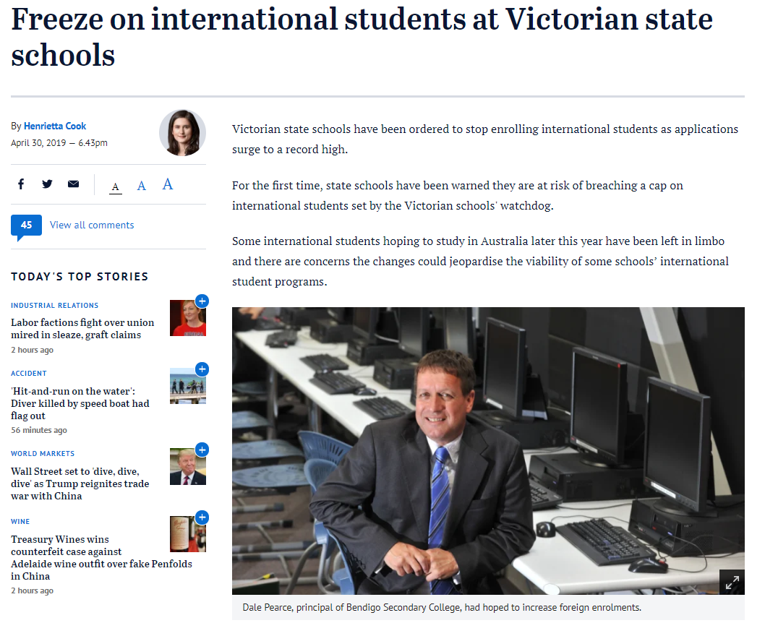
International students in Australia
(Worthington, 2019)
(Cook, 2019)

Slide 4
Current context
3.5 million international students worldwide in 2016 (OECD, 2018).
Enrolments in Australia have almost doubled in 10 years (Department of Education and Training, 2019b).
Australia is the 3rd most popular destination for overseas study (ICEF Monitor, 2018).
International education is worth $34.9 billion to Australia’s economy (ICEF Monitor, 2019).
The average international student spends an average of $45,000 per year for living expenses and university fees combined (HSBC, 2013).

Slide 5
Discussion
Besides English comprehension, what do you think international students find difficult in their transition to studying in an Australian context?

Slide 6
Program Background
Rational for implementation:
Language-based support oriented around course assessments
Initial implementation and challenges:
Timetabling, promotion, eligible students, ongoing support - academics
Student eligibility and response
Concentration of international students
Duration of support extended
Students appreciate neutral, third-party support

Slide 7
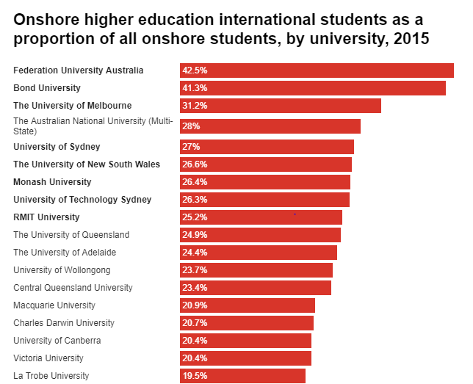
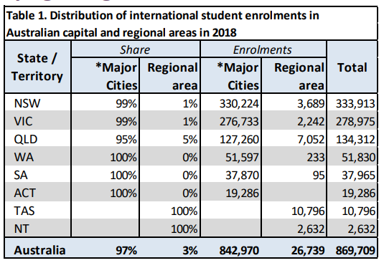
Enrolments
(Department of Education and Training, 2019b)
(Department of Education and Training, as cited in Hare, 2017)
(Department of Education and Training, 2019a)

Slide 8
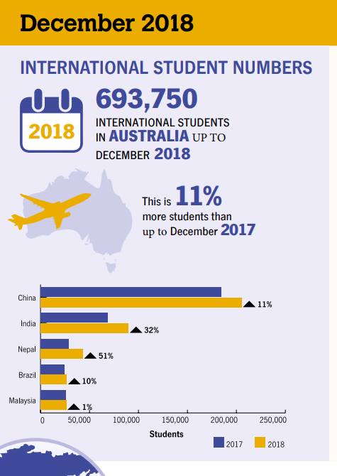
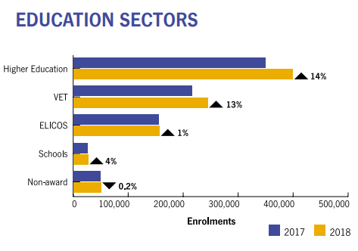
(Department of Education and Training, 2018)

Slide 9
Cohort and needs
Chinese students
Full degree and partner students
Reading and writing vs speaking and listening
Engage with support (in a group)
Here to study
Indian students
Speaking and listening vs reading and writing
Engage with support (individually and group)
Placement experiences
Commuting and working

Slide 10
IELTS
(IELTS, 2014)
Notes:
While the official IELTS Handbook advises that an overall band score of 7.0 is “probably acceptable” for “linguistically demanding” academic courses, overall band scores of 5.5 and 6.5 are accompanied by the recommendation “English study needed” (2005, p5)
This advice implies that it is the responsibility of universities to provide additional English language support to students when admitted to “linguistically demanding” courses at these lower levels. However, some subjects offered by the family are less “linguistically demanding” than others. Therefore, this advice would need to be more strongly heeded in some subjects than others.

Slide 11
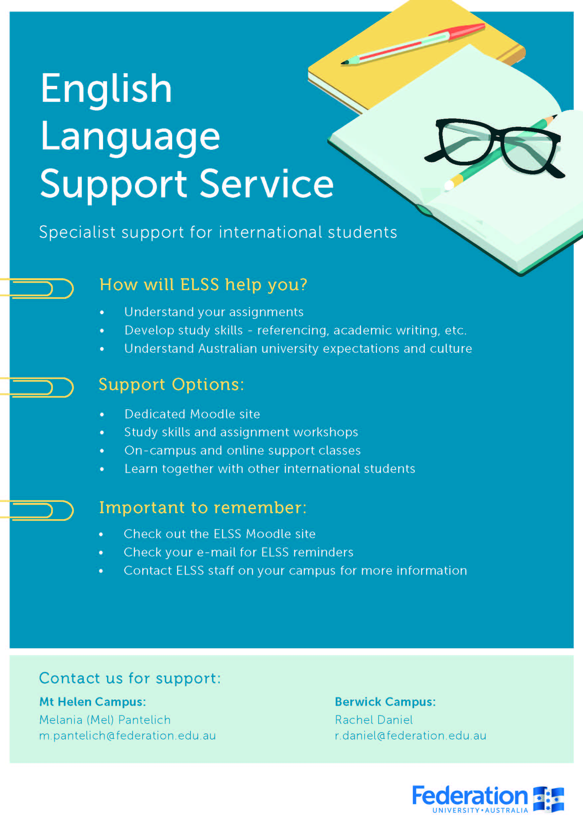
Promotion
ELSS presentation at enrolment day
Advertisement in Student Diary
Fed Uni website and International Course Guide
Attend first lecture of selected courses
Lecturer encouragement throughout semester
Electronic communication (Fed Uni and personal)
Pamphlets and posters
Moodle - announcements

Slide 12
Program Delivery
Nature of support:
 | Semester One | Semester Two
2014 | 26 | 66
2015 | 37 | 64
2016 | 104 | 210
2017 | 270 | 194
2018 | 142 | 255
Weekly classes
Assignment Workshops
Study Skills Workshops
Moodle support
Online classes
Consultations (incl. Pastoral Care)
Embedded support – upon request
Drop-in sessions

Slide 13
Focus of Program
Connection to degree assignments
Classes directly relevant to students’ university workload
Areas covered include:
Course content
How to approach assignments
Referencing
Researching
Academic writing:
report and essay writing paraphrasing and summarising
Critical thinking
Communication with academics and fellow students
Learning in lecture and tutorial environments
Transition to university life in Australia

Slide 14
Weekly classes
Timetabled
Nursing (1st and 2nd Year)
Fundamentals of Law
Master of Social Work
Tailored to degree needs
Collaboration with lecturers
Moodle shell access (assignments and course content)
Clarification
Course content breakdown, assignments and study skills

Slide 15
Master of Social Work Weekly Plan (online classes)
Week 2 | APA Referencing session
Week 3 | Assignment 1: Annotated Bibliography and paraphrasing
Week 4 | Assignment 2: PowerPoint assignment and sentence length
Week 5 | Critical thinking and research
Week 6 | Essay writing and academic writing (paraphrasing, paragraphs)
Week 7 | Assignment 3: 3,000 word essay requirements and incorporating evidence
Week 8 | Essay help - Casual question and answer session
Week 9 | Assignment 4: Reflective journal and reflective writing
Week 10 | Assignment 5: Role play, questioning, summarisation, interpretation, etc.
Week 11 | Assignment 6: Critical reflection essay based on role play
Week 12 | Critical reflection – casual question and answer session

Slide 16
Example assignment
Issues?
Clear instructions?
Technology skills
Writing for PPT
Presenting information
Making links
Showing understanding
…?

Slide 17
Example submission
Notes:
PPT – 11 out of 20 mark

Slide 18
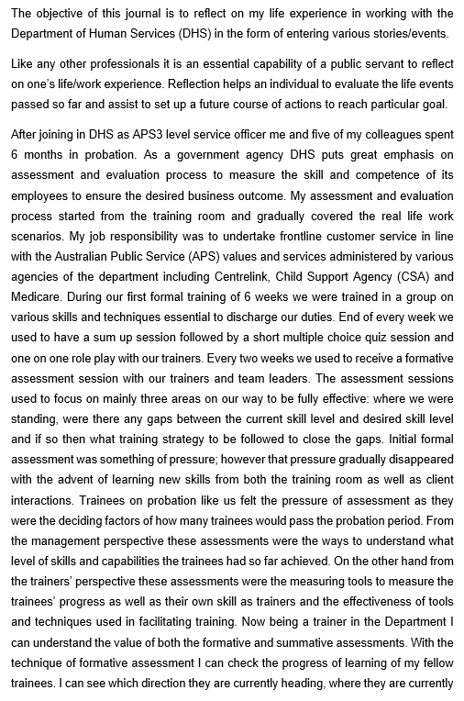

Slide 19
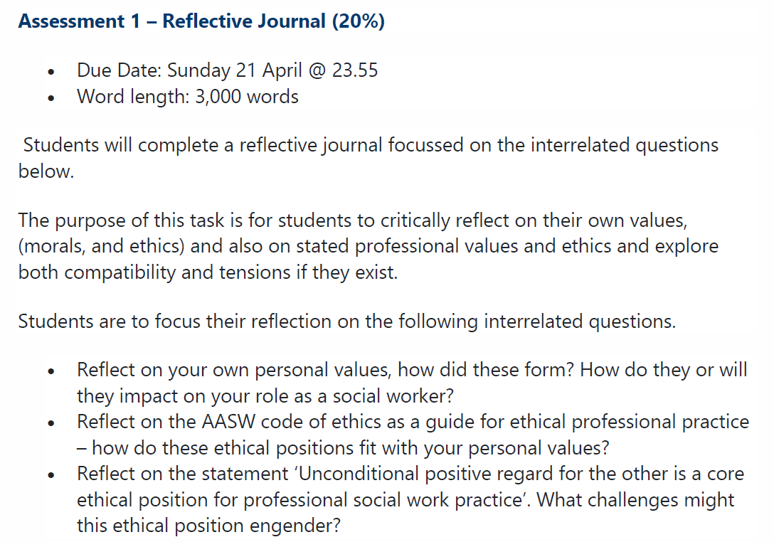
Building skills – reflective writing

Slide 23
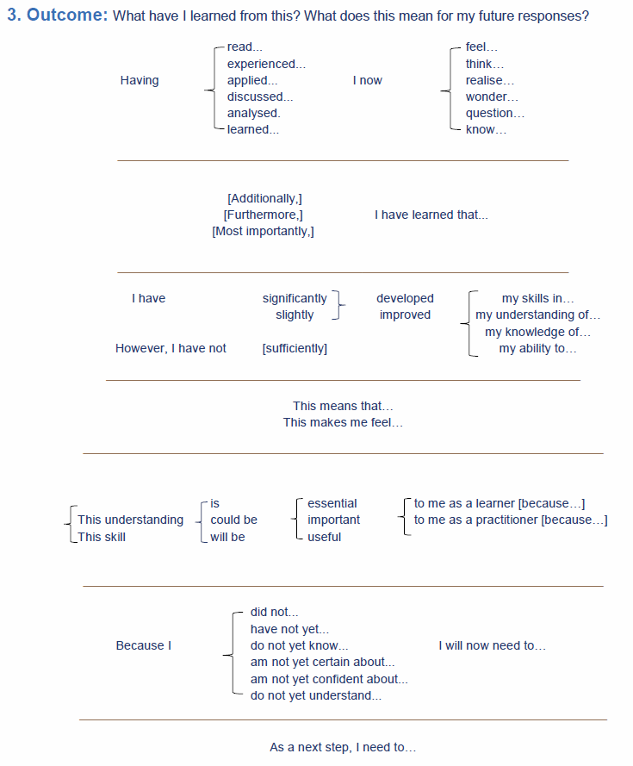

Slide 24
Result

Slide 25
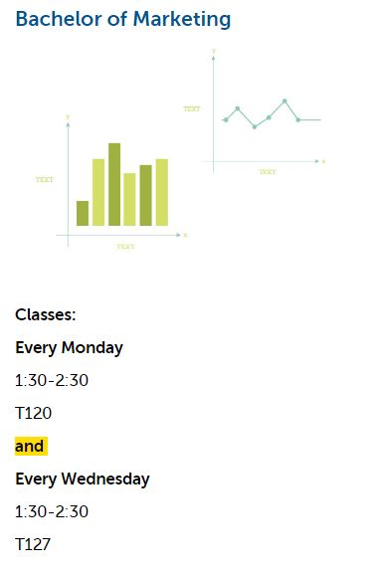
Moodle
Communication with students
Forums
Online class delivery and recordings
Database of resources

Slide 26
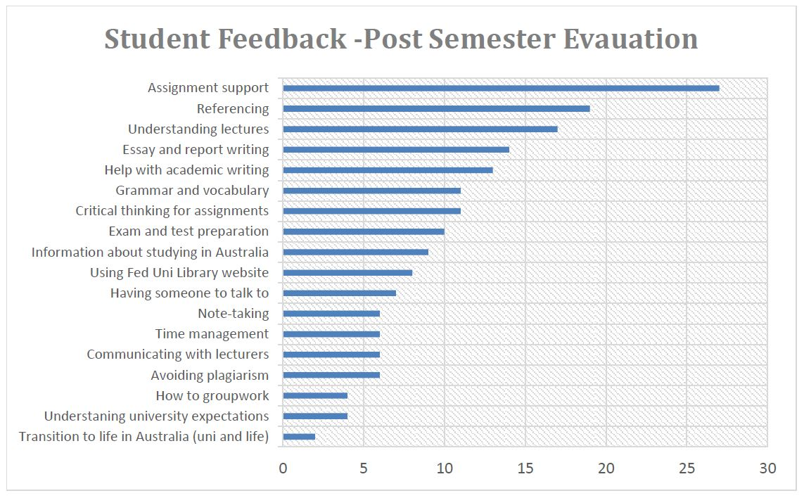
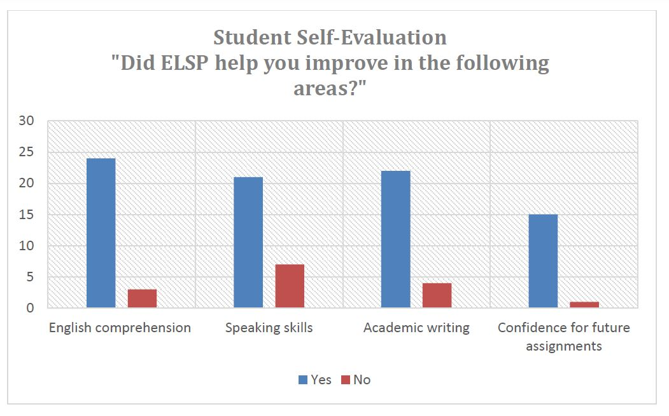
Evaluation

Slide 27
Student Feedback
“I hope you can teach me grammar.”
“Cover more course; More skill about learning and writing.”
“More ELSS CLASS!!!”
“I want ELSS class next semester.”
“I think it is very helpful for me to get a better understanding with lectures.”
“I need individual concentration classes on improving my vocabulary.”
“Could please have more class time? Two classes per week is not enough.”
“It is an excellent program for international students. Referencing was very new to me. Received great support from Melania. Also had doubts regarding education system in Australia, which Melania helped us out in understanding. Also helped us in understanding Australian culture, people and the country.”

Slide 28
Future Plans
Expansion of online support as technology changes
Pre-recorded Study Skills Workshops
Fully customise teaching materials and resources
Pre-arrival material to aid acclimatisation to accents
ELSS staff on all campuses

Slide 29
Discussion questions
Would there be similar issues for international EAL/ESL/NESB high school students entering university in Australia?
Aside from English language competency, what is the most important skill for success in post-secondary studies?

Slide 30
References
Cook, H. (2019). Freeze on international students at Victorian state schools. Retrieved from
https://www.theage.com.au/national/victoria/freeze-on-international-students-at-victorian-state-schools-20190430-p51ipq.html
Department of Education and Training. (2018). International student data monthly summary. https://internationaleducation.gov.au/research/International-Student-Data/Documents/MONTHLY%20SUMMARIES/2018/Dec%202018%20MonthlyInfographic.pdf
Department of Education and Training. (2019a). International student data. Retrieved from https://internationaleducation.gov.au/research/International-Student-Data/Pages/InternationalStudentData2019.aspx
Department of Education and Training. (2019b). International students studying in regional areas. Retrieved from https://internationaleducation.gov.au/research/Research-Snapshots/Documents/Location%20of%20International%20Students%20in%202018.pdf
Hare, J. (2017). We need to make sure the international student boom is sustainable. Retrieved from https://theconversation.com/we-need-to-make-sure-the-international-student-boom-is-sustainable-86394
HSBC. (2013). Australia most expensive country for international study, but the tide may turn. Retrieved from https://www.about.hsbc.com.au/-/media/australia/en/news-and-media/2013-08-13-press-release-australia-the-most-expensive-country-for-international-study-but-tide-may-turn-public+&cd=3&hl=en&ct=clnk&gl=au
ICEF Monitor. (2018). Australia’s international education exports grew by 22% in 2017. Retrieved from http://monitor.icef.com/2018/04/australias-international-education-exports-grew-22-2017/
ICEF Monitor. (2019). Double-digit growth for Australia’s foreign enrolment in 2018. Retrieved from http://monitor.icef.com/2019/03/double-digit-growth-australias-foreign-enrolment-2018/
IELTS. (2014). Guide for educational institutions, governments, professional bodies and commercial organisations. Retrieved from https://www.ielts.org/-/media/publications/guide-for-institutions/ielts-guide-for-institutions-uk.ashx?la=en-us
OECD. (2018). Education at a Glance 2018: OECD indicators. Retrieved from https://www.oecd-ilibrary.org/docserver/eag-2018-en.pdf?expires=1557386444&id=id&accname=guest&checksum=6B0CC285CA7D298D3436E6B04CF639CA
Worthington, E. (2019). Universities ignoring own English standards to admit more high-paying international students. Retrieved from https://www.abc.net.au/news/2019-05-06/universities-lowering-english-standards/11063626

Slide 31
Questions?
Thank you!
Melania Pantelich
m.pantelich@federation.edu.au

